Slide 1
Iot project presentation
Smart Home dashboard
Mihai Serban

Slide 2
Agenda
Project Overview
Dashboard
Project Wiring
Individual Roles and Tasks
Phases and their tasks
Challenges and Accomplishments

Slide 3
Project overview
The IoT project focused on making a smart home. We collected data from sensors, sent it to the Raspberry Pi (Rpi), made decisions based on that data, and showed the results on the dashboard. The aim was to demonstrate how various parts of a smart home can work well together.

Slide 4
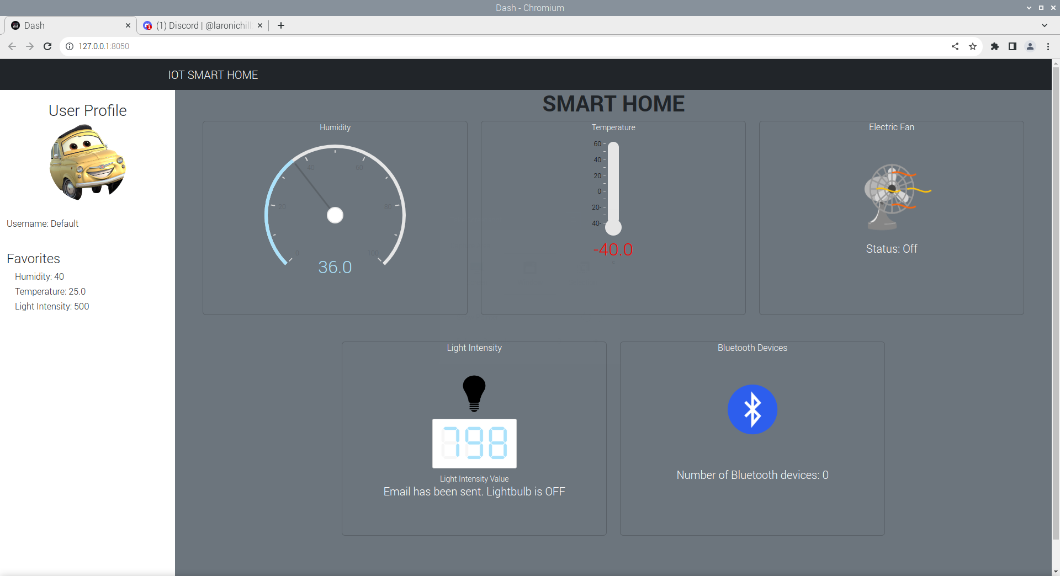
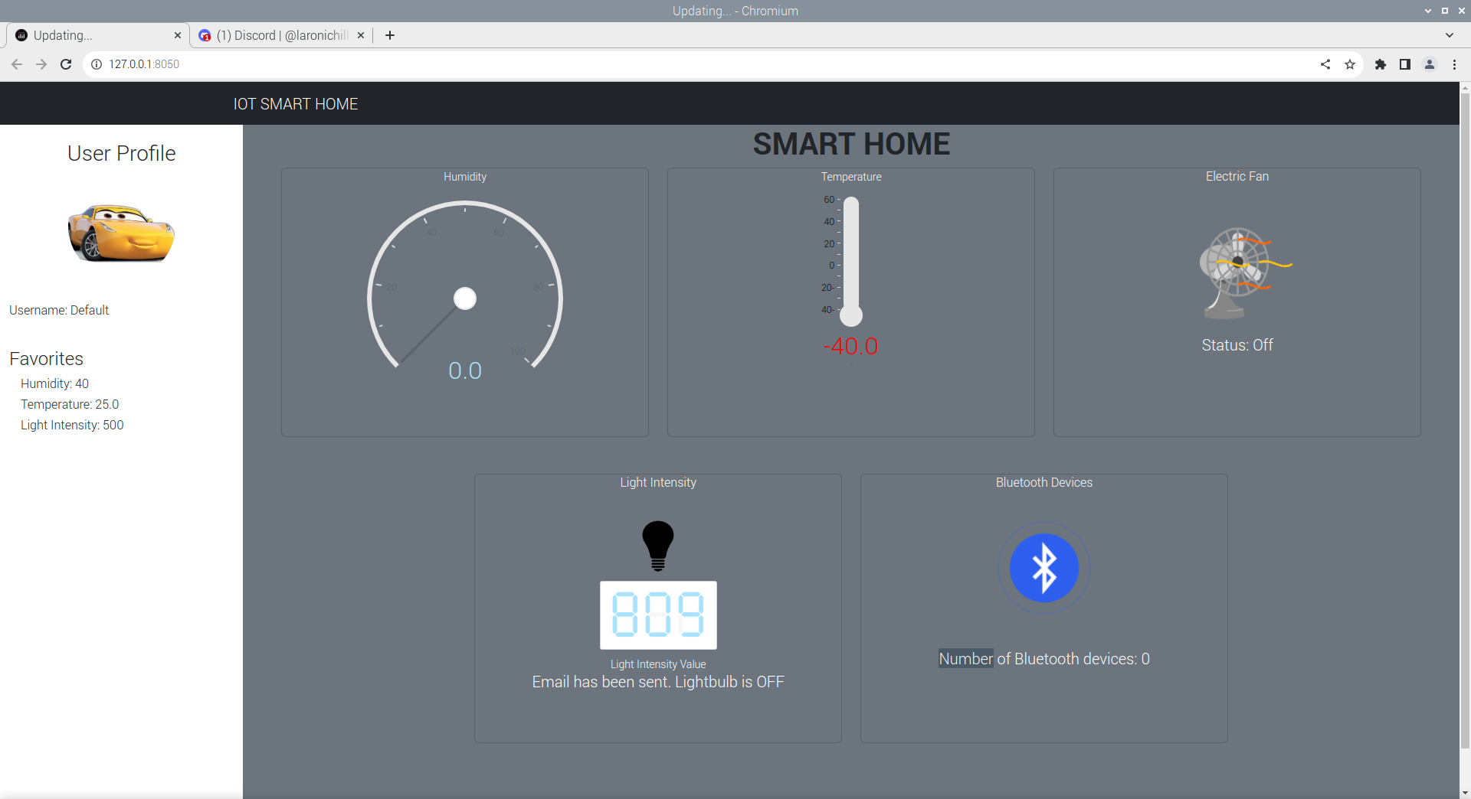
Dashboard
Default
RFID card tapped => User1

Slide 5
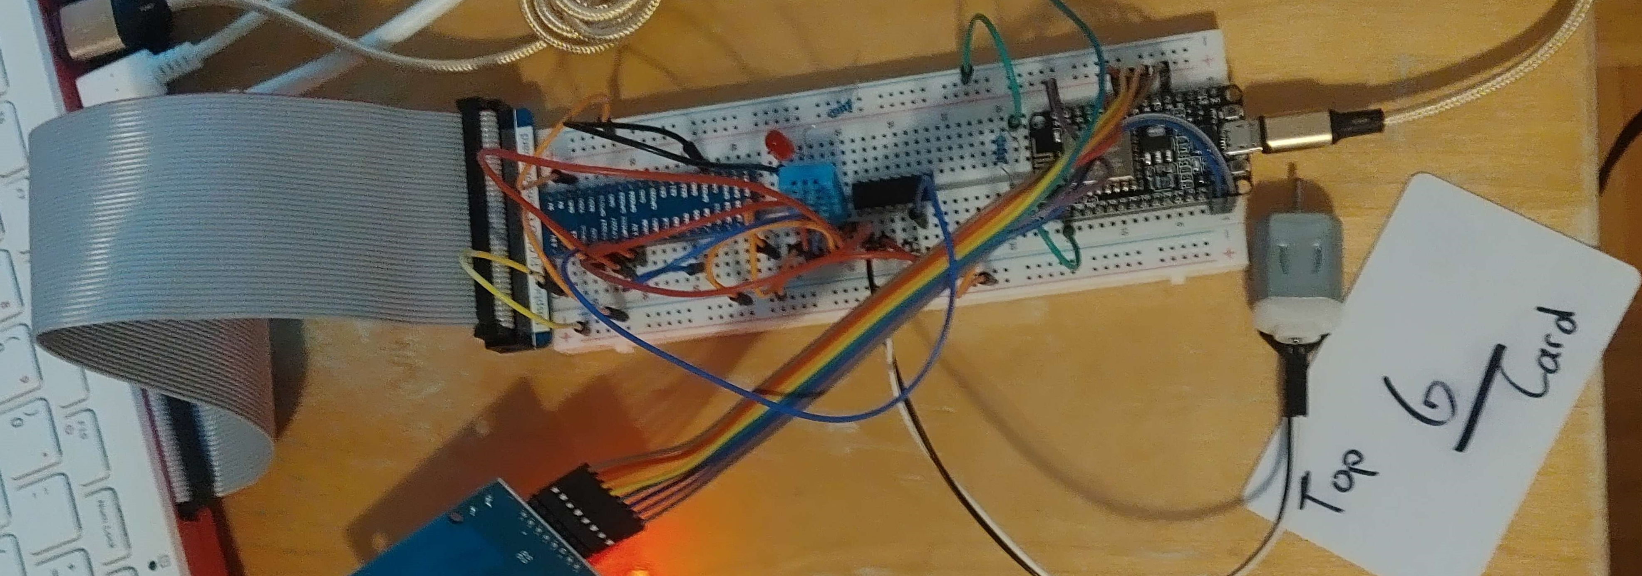
The project wiring

Slide 6
Individual Roles and Tasks
Phase 1
Phase 2
Mihai
Initial Setup and basic dashboard
Jerico
Found Picture and click
Sayem
Overview and debug
Mihai
Debugging and Wiring issues fixed
Jerico
Designed the wiring
Sayem
Added code to dashboard.py

Slide 7
Individual Roles and Tasks
Phase 3
Phase 4
Jerico and Sayem did most of the work
Mihai only helped debugging in class
Mihai did everything
Documentation
Powerpoint
Dashboard and RFID addition
Github setup
Fritzing wiring
Etc.

Slide 8
Phases and their tasks
Phase 1 - description
In this phase, we create an IoT dashboard that can turn on and off a led on the breadboard from a simple click.

Slide 9
Phases and their tasks
Phase 1 - UTILITIES
Components
Resistors
Wires
LED
Breadboard
Raspberry Pi
Libraries
Dash
dash_daq
time
RPi.GPIO

Slide 10
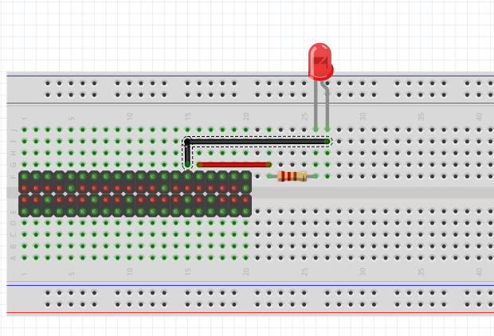
Phases and their tasks
Phase 1 - Wiring

Slide 11
Phases and their tasks
Phase 2 - description
In this phase, we create an IoT dashboard displaying temperature and humidity using gauges. When the temperature exceeds a certain threshold, an automatic email is sent to the user, asking if they want to start the fan. If the user agrees, the system activates the fan and updates its status on the dashboard. If not, no action is taken.

Slide 12
Phases and their tasks
Phase 2 - UTILITIES
Components
DHT11 Temperature and Humidity sensor
Resistors
Wires
DC motor
IC L293D (Motor Driver)
Breadboard
Raspberry Pi
Libraries
Dash
datetime
dash_daq
time
Freenove_DHT
smtplib
email
Imaplib
RPi.GPIO

Slide 13
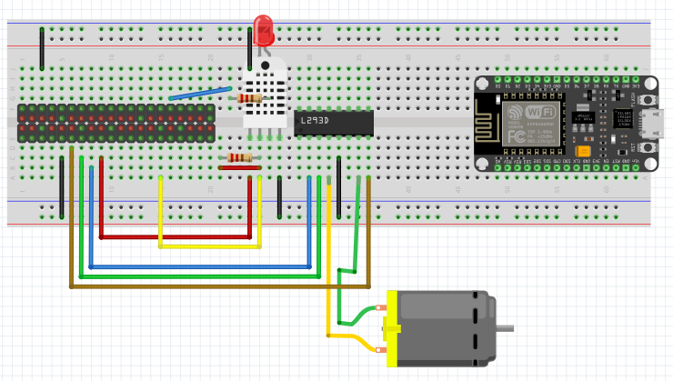
Phases and their tasks
Phase 2 - Wiring

Slide 14
Phases and their tasks
Phase 3 - description
In this part, we had to use a photoresistor with the ESP8266/ESP32 to measure light. We then sent this data to the Raspberry Pi and MQTT broker. If the light went below 400, we turned on an LED and sent an email. The dashboard had to show the current light level, its status, and confirm the email was sent.

Slide 15
Phases and their tasks
Phase 3 - UTILITIES
Components
Photoresistor
Resistors
Wires
Breadboard
Raspberry Pi
ESP8266 or ESP32
LED
Libraries
Sqlite3
paho.mqtt.client (mqtt)
datetime
time
Freenove_DHT
smtplib
MIMEText
MIMEMultipart
email
Imaplib
ESP8266WiFi.h
PubSubClient.h
Arduino.h

Slide 16
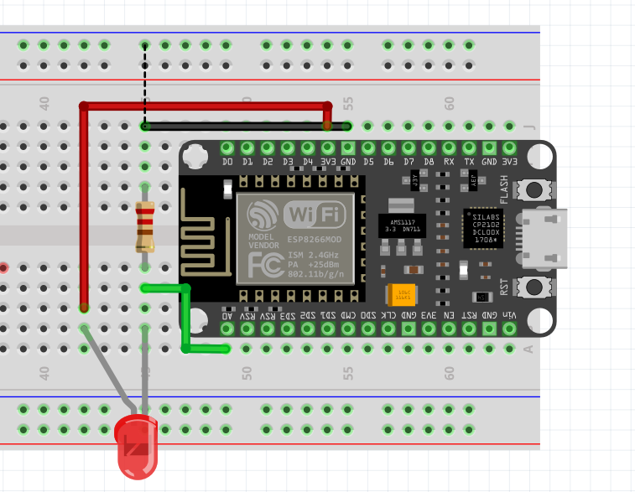
Phases and their tasks
Phase 3 - Wiring

Slide 17
Phases and their tasks
Phase 4 - description
Task #1 involves creating user profiles with RFID tag numbers, temperature thresholds, and light intensity thresholds. When an RFID tag is read, the system updates thresholds based on the user's profile and sends an email notifying the entry time. The dashboard displays user profile information.
Task #2 focuses on counting nearby Bluetooth-enabled devices.

Slide 18
Phases and their tasks
Phase 4 - UTILITIES
Components
Photoresistor
Resistors
Wires
Breadboard
Raspberry Pi
ESP8266 or ESP32
LED
RC522 RFID Module
Libraries
Bluepy.btle
Sqlite3
datetime
time
Freenove_DHT
smtplib
MIMEText
MIMEMultipart
email
Imaplib
ESP8266WiFi.h
PubSubClient.h
Arduino.h

Slide 19
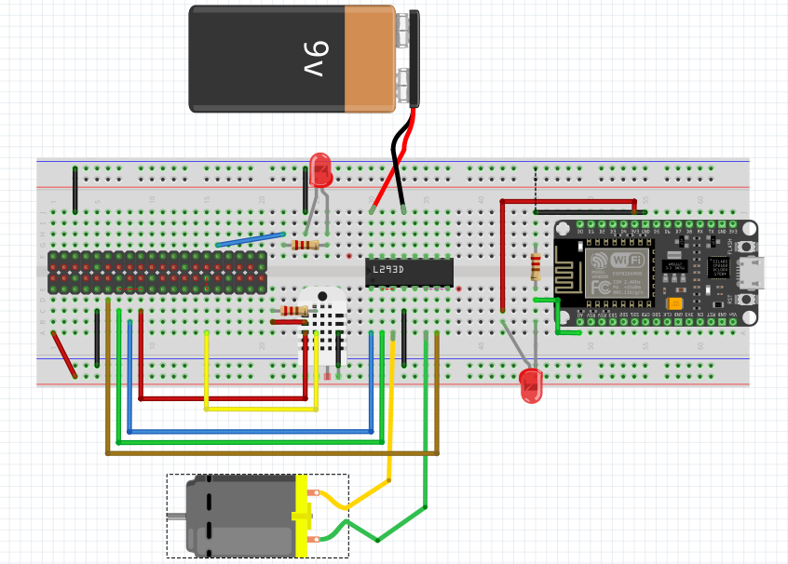
Phases and their tasks
Phase 4 - Wiring

Slide 20
Phases and their tasks
Phase 4 – In real time

Slide 21
Phases and their tasks
Phase 4 – Dashboard

Slide 22
Problems encountered
After getting kicked, I had little to no data on our project apart from phase 2 and phase 3 code.

Slide 23
Challenges and Accomplishments
PHASE 1
Installation of Dash was unclear when it came to the specifications and recommendations. Had to reinstall twice.
PHASE 2
Writing code for the email reading was very difficult with Gmail as the documentation online was either off or obsolete.
PHASE 3
Very difficult with no knowledge to set up the database
PHASE 4
Incredibly slow dashboard. Impossible to debug unless you use a second computer. Microcontrollers burning out from having to rewire every time you work on it.

Slide 24
Challenges and Accomplishments
We've successfully engineered a sophisticated simulated smart home, integrating an assortment of advanced components—sensors, motors, a single-board computer, and microcontrollers. Our project unfolded in four distinct phases, encompassing the development of a smart thermometer system, an intelligent lighting setup, an occupancy detection system, and a personalized user profile module.

Slide 25
THANK YOU
Mihai Serban​

Slide 26
We made it

